Slide 1
“5050” LED Street light lens
80X60
optical simulation report
2018-08-15

Slide 2
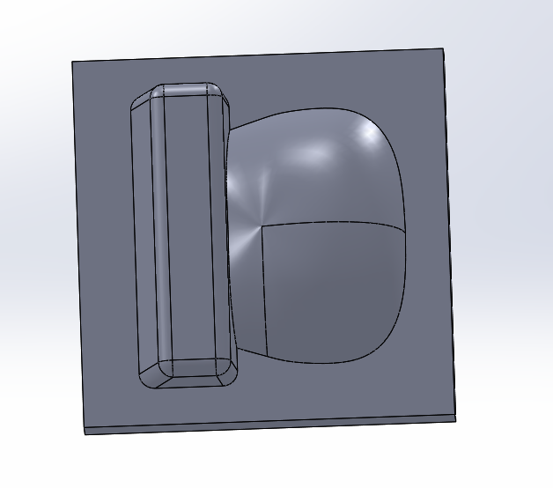
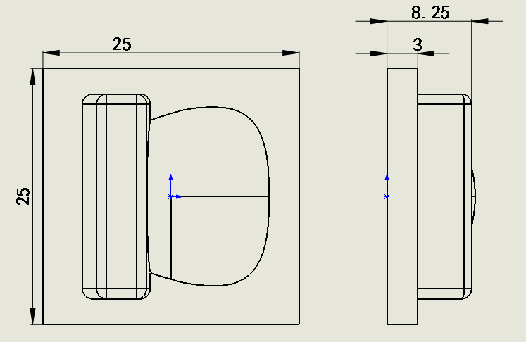
Lens Layout

Slide 3
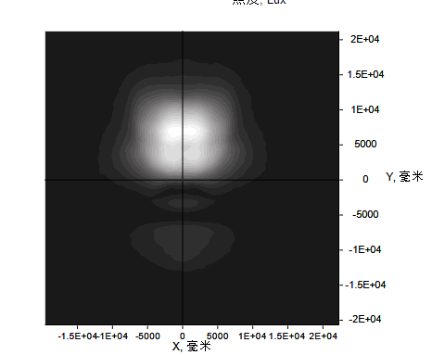
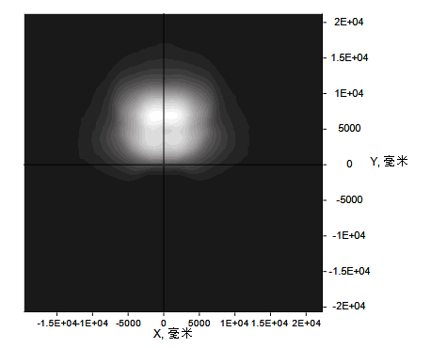
Total—Irradiance map for incident flux Black（1m）
Add black reflective strip

Slide 4
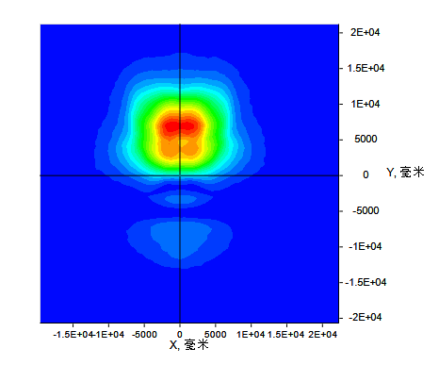
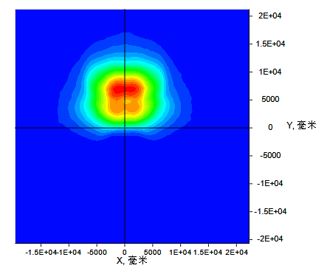
Total—Irradiance map for incident flux color（1m）
Add black reflective strip

Slide 5
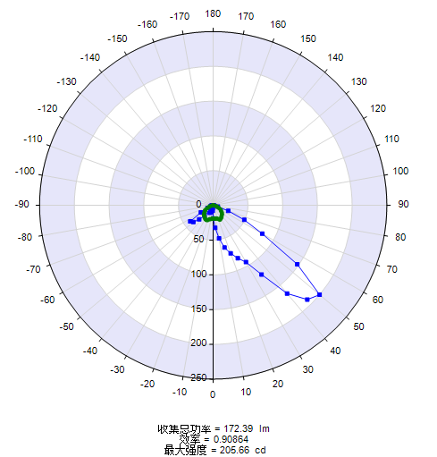
Light distribution curve
Effeciency: 90.8%

